Slide 1
Root and Rule-Based Natural Language Processing:
Subject-Predicate-Object Phrases
Peter Zhang and Jonah Tash

Slide 2
Motivation
We have used a root and rule-based programs
Can identify terms and build taxonomies
Next step is to identify relations and build RDFs
We want to express the terms and sentences in subject-predicate-object groups

Slide 3
Example
The crystal packing is mainly stabilized by van der Waals interactions
crystal:0:packing
van:2:der:1:waals:0:interacitons
crystal packing
stabilized by
Van der Waals interactions
Subject
Predicate Phrase
Object

Slide 4
Tagging Verb
Searching for Predicates
Clustering Stems
Curating Predicates
Building Predicate Phrases
R&R Term
Selecting Subjects & Objects
Process

Slide 5
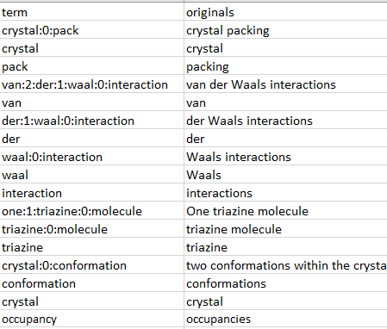
R&R Term
The crystal packing is mainly stabilized by van der Waals interactions
One triazine molecule is disordered over two conformations within the crystal, the occupancies being 62 emsp14 (1) and 38 emsp14

Slide 6
Selecting Subjects & Objects
Considered only short noun phrases
Want precise but useful search terms
Subjects and objects should be concise
Consider terms of level 0, 1 and 2

Slide 7
Selecting Subjects & Objects

Slide 8
Step 1: Tagging Verbs
Use the part-of-speech tagger in the Natural Language Toolkit (NLTK) library to identify verbs
The model is trained by machine learning
It can isolate the sense of a word
E.g. “I wrote the report.” ⇨ “report” noun
“I report the news” ⇨ “report” verb
Found at: https://www.nltk.org/

Slide 9
Step 1: Cross-Checking
NLTK is not perfect
Model is trained on ordinary literature, not scientific vocabulary
Symbols and molecule names are sometimes incorrectly classified as verbs
E.g. “middot” in KNa[H6PtMo6O24] middot 11H2O
“oxazolo” in “oxazolo[3,2-c]pyrimidin-1-one hydrate”

Slide 10
Step 1: Cross-Checking
First, check results with Princeton’s WordNet lexicon of verbs
Ensures a valid verb form is tagged
E.g. removes “middot” and “oxazolo”
Second, remove tagged “verbs” that also appear in the terms
Some verb forms appear in noun phrases
E.g. “packing” in “crystal packing”
Found at: https://wordnet.princeton.edu/

Slide 11
Step 2: Grouping Terms
Classify terms into Level 0, 1, and 2 by maximum colon number
Higher level means a longer phrase
E.g. “crystal:0:packing” ⇨ Level 0
“van:2:der:1:waals:0:interaction” ⇨ Level 2
Conduct searches first on only Level 0 terms, then on Level 0 and Level 1, and finally on all three levels

Slide 12
Step 2: Locating All Verbs
Search the span between subject and object for verbs
E.g. between “crystal packing” and “Van der Waals interactions”
Count the number of characters and words in the span
The crystal packing is mainly stabilized by van der Waals interactions
Span
Characters: 23
Words: 4

Slide 13
Step 3: Catching Conjugations
A verb by itself is not precise enough
Not useful for searches
E.g. “was”, “have”, “link”
Use the Collaborative International Dictionary of English to capture conjugations of the verb
Hand-collected a list of English conjugations
E.g. is linking, was linked, will link
Found at: http://www.ibiblio.org/webster/

Slide 14
Step 3: Collating Prepositions
Reference the Pattern Dictionary of English Propositions to append neighboring prepositions
e.g. “stabilized” ⇨ “stabilized by”
“connect” ⇨ “connect to”
“extracting” ⇨ “extracting from”
Found at: https://www.clres.com/pdep.html

Slide 15
Step 4: Stemming Verb Forms
Want to group synonymous verb phrases
Reference the British National Corpus to find the “stem” of each verb phrase
E.g. “is” ⇨ “be”
“stabilized by” ⇨ “stabilize”
Found at: https://github.com/skywind3000/lemma.en

Slide 16
Step 4: Clustering Synonyms
Reference the Princeton’s WordNet lexicon to find synonyms for the stems
Use these to cluster similar phrases
E.g. “appear” ⇨ {“appear”, “seem”, “look”}
“bond” ⇨ {“bond”, “bind”, “attach”, “adhere”, “stick”}
Found at: https://wordnet.princeton.edu/

Slide 17
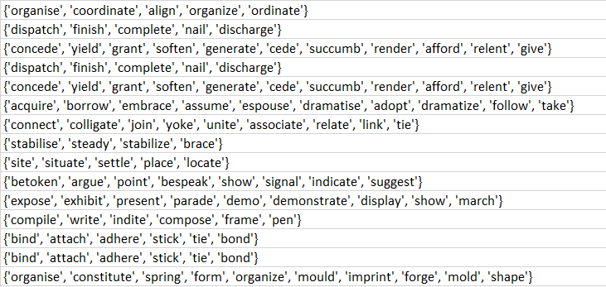
Step 4: Clustering

Slide 18
Step 5: Curation
Count the number of each subject, predicate, object, and verb stem
Sort by frequency and identify phrases to ignore
Some predicate phrases lack meaningful relation
E.g. “is”, “was”, “are”, “have”
Locally compile phrases to filter out

Slide 19
Output
For an input of 67k terms in 5681 sentences, the program extracts 5700+ pairs in under 15 seconds
Output to a CSV file with the following columns:
Subject, Object, Predicate
Sentence
Stem and Synonyms
Frequencies of Subject, Object, Predicates and Stems
R&R Terms for Subject, Object, and Predicate
Document ID

Slide 20
Output
{‘quaternary structure’, ‘exhibits’, ‘considerable variability’}
{‘quaternary:0:structure’, ‘exhibits’, ‘considerable:0:variability’}
However the quaternary structure exhibits considerable variability
{‘Cl hydrogen bonds’, ‘stabilize’, ‘crystal structure’}
{‘CI:2:hydrogen:bond’, ‘stabilize’, ‘crystal:0:structure’}
Cl hydrogen bonds help to stabilize the crystal structure
{‘three lobes or fingers’, ‘delineate ‘, ‘central binding groove and additional grooves’}
{‘finger:0:lobe’, ‘delineate’, ‘lobe:0:lobe:2:additional:0:groove:1:central:0:bind:1:groove’}
The three lobes or fingers delineate a central binding groove and additional grooves between lobes 1 and 3 and between lobes 2 and 3

Slide 21
Output

Slide 22
Implementation
The program was written in Python with use of the NLTK, CSV and SQLite3 libraries
Compilers for the verb, predicate, and lemma dictionaries are available as separate programs
Dictionaries can be easily expanded and re-integrated
Filtered words are manually stored in a separated in a CSV file

